Slide 1
DESIGN & IMPLEMENTATION OF AN OPEN-SOURCE WIRELESS SENSOR NETWORK DEVELOPMENT PLATFORM “MOTESQUITO”
Presented by:
Disha Srivastava
Swapnil Modak
ECGR 6185
Advanced Embedded Systems

Slide 2
OVERVIEW
INTRODUCTION TO WIRELESS SENSOR NETWORKS
INTRODUCTION TO MOTESQUITO
SOFTWARE IMPLEMENTATION
CONCLUSION

Slide 3
INTRODUCTION
Wireless Sensor Networks
Expanding research field hence growing need for a variety of development platforms
WSN development boards provides interfaces to hardware, radios and routing protocols
Selection of boards limited due to availability, cost and use of proprietary software
Most commonly used WSN development tool : TinyOS

Slide 4
INTRODUCTION
Motesquito is designed to avoid the limitations presented by the TinyOS platform
The board will include a large software library and sockets for wireless module
Currently the Digi Xbee radio modules are used
Renesas and Arduino development boards with Xbee slots embedded into hardware are used

Slide 5
SOFTWARE IMPLEMENTATION
Developed a software library to provide interfaces to Motesquito’s peripherals
User can load Arduino bootloader onto microcontroller and used Arduino XBee library to interface XBee module
To configure the module as a Coordinator or as an End device, a C library is created to construct and send packages, receive packages and change XBee settings

Slide 6
SOFTWARE IMPLEMENTATION
The library supports both Series 1 and Series 2 XBee modules
It also includes a hardware abstraction layer, so users can use the software with other microcontrollers
For testing our code we used the Renesas RX63N development board

Slide 7
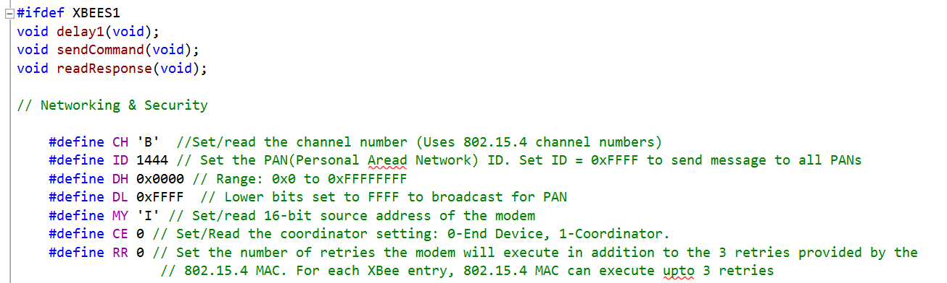
Parameters were defined in the Xbee_Config.h file with a certain default value. The range of all possible values is also specified as comments with the defined parameters.

Slide 8
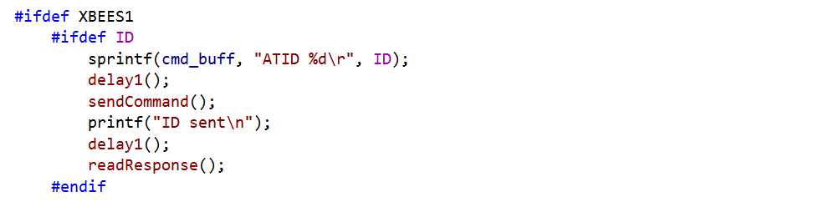
Since all the command need to be sent via UART, the AT command need to be converted into a string and stored in a buffer. This buffer is then used to send the commands byte-by-byte.

Slide 9
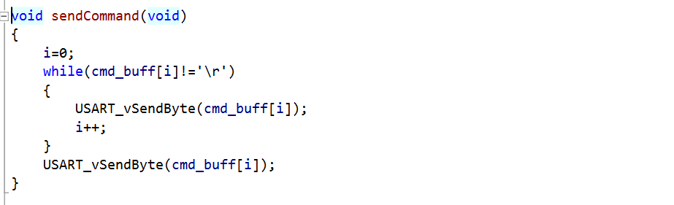
The sendCommand() function takes the data stored in cmd_buff[] and passes it to USART_vSendByte() which transmits it via the UART.

Slide 10
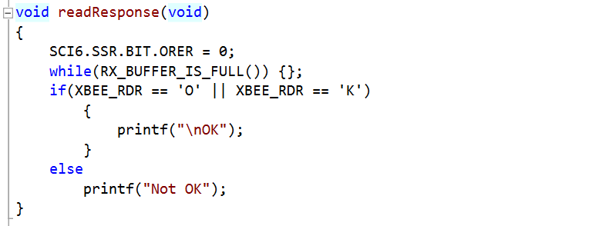
The readResponse() function is used to read the receive data buffer and check for characters ‘0’ & ‘K’. Print OK if found else print Not OK

Slide 11
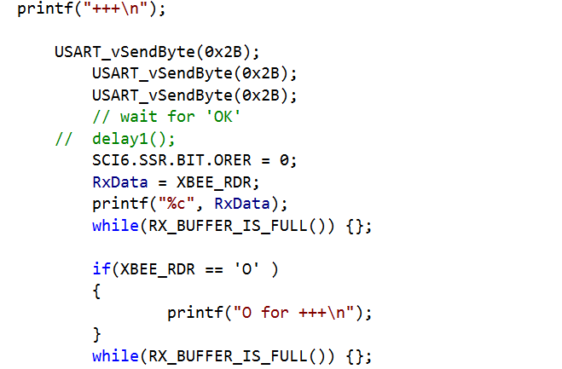
Here the USART_vSendByte() is used to send ‘+++’ command as ‘0x2B’ one byte at a time, and wait for response OK by the Xbee. This command puts the Xbee in command mode enabling other AT commands to work.

